Slide 1


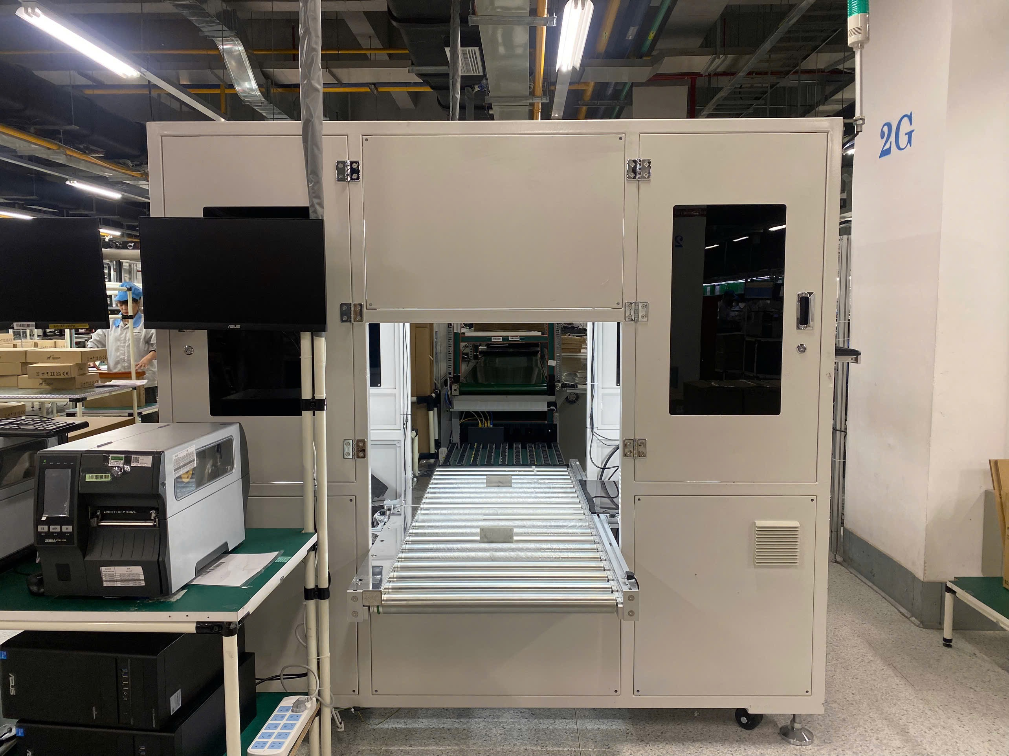
BG6
PVN
PVN- LINE 4K- Improve station AOI Carton
AOI Carton
FME
BG6 PVN

Slide 2
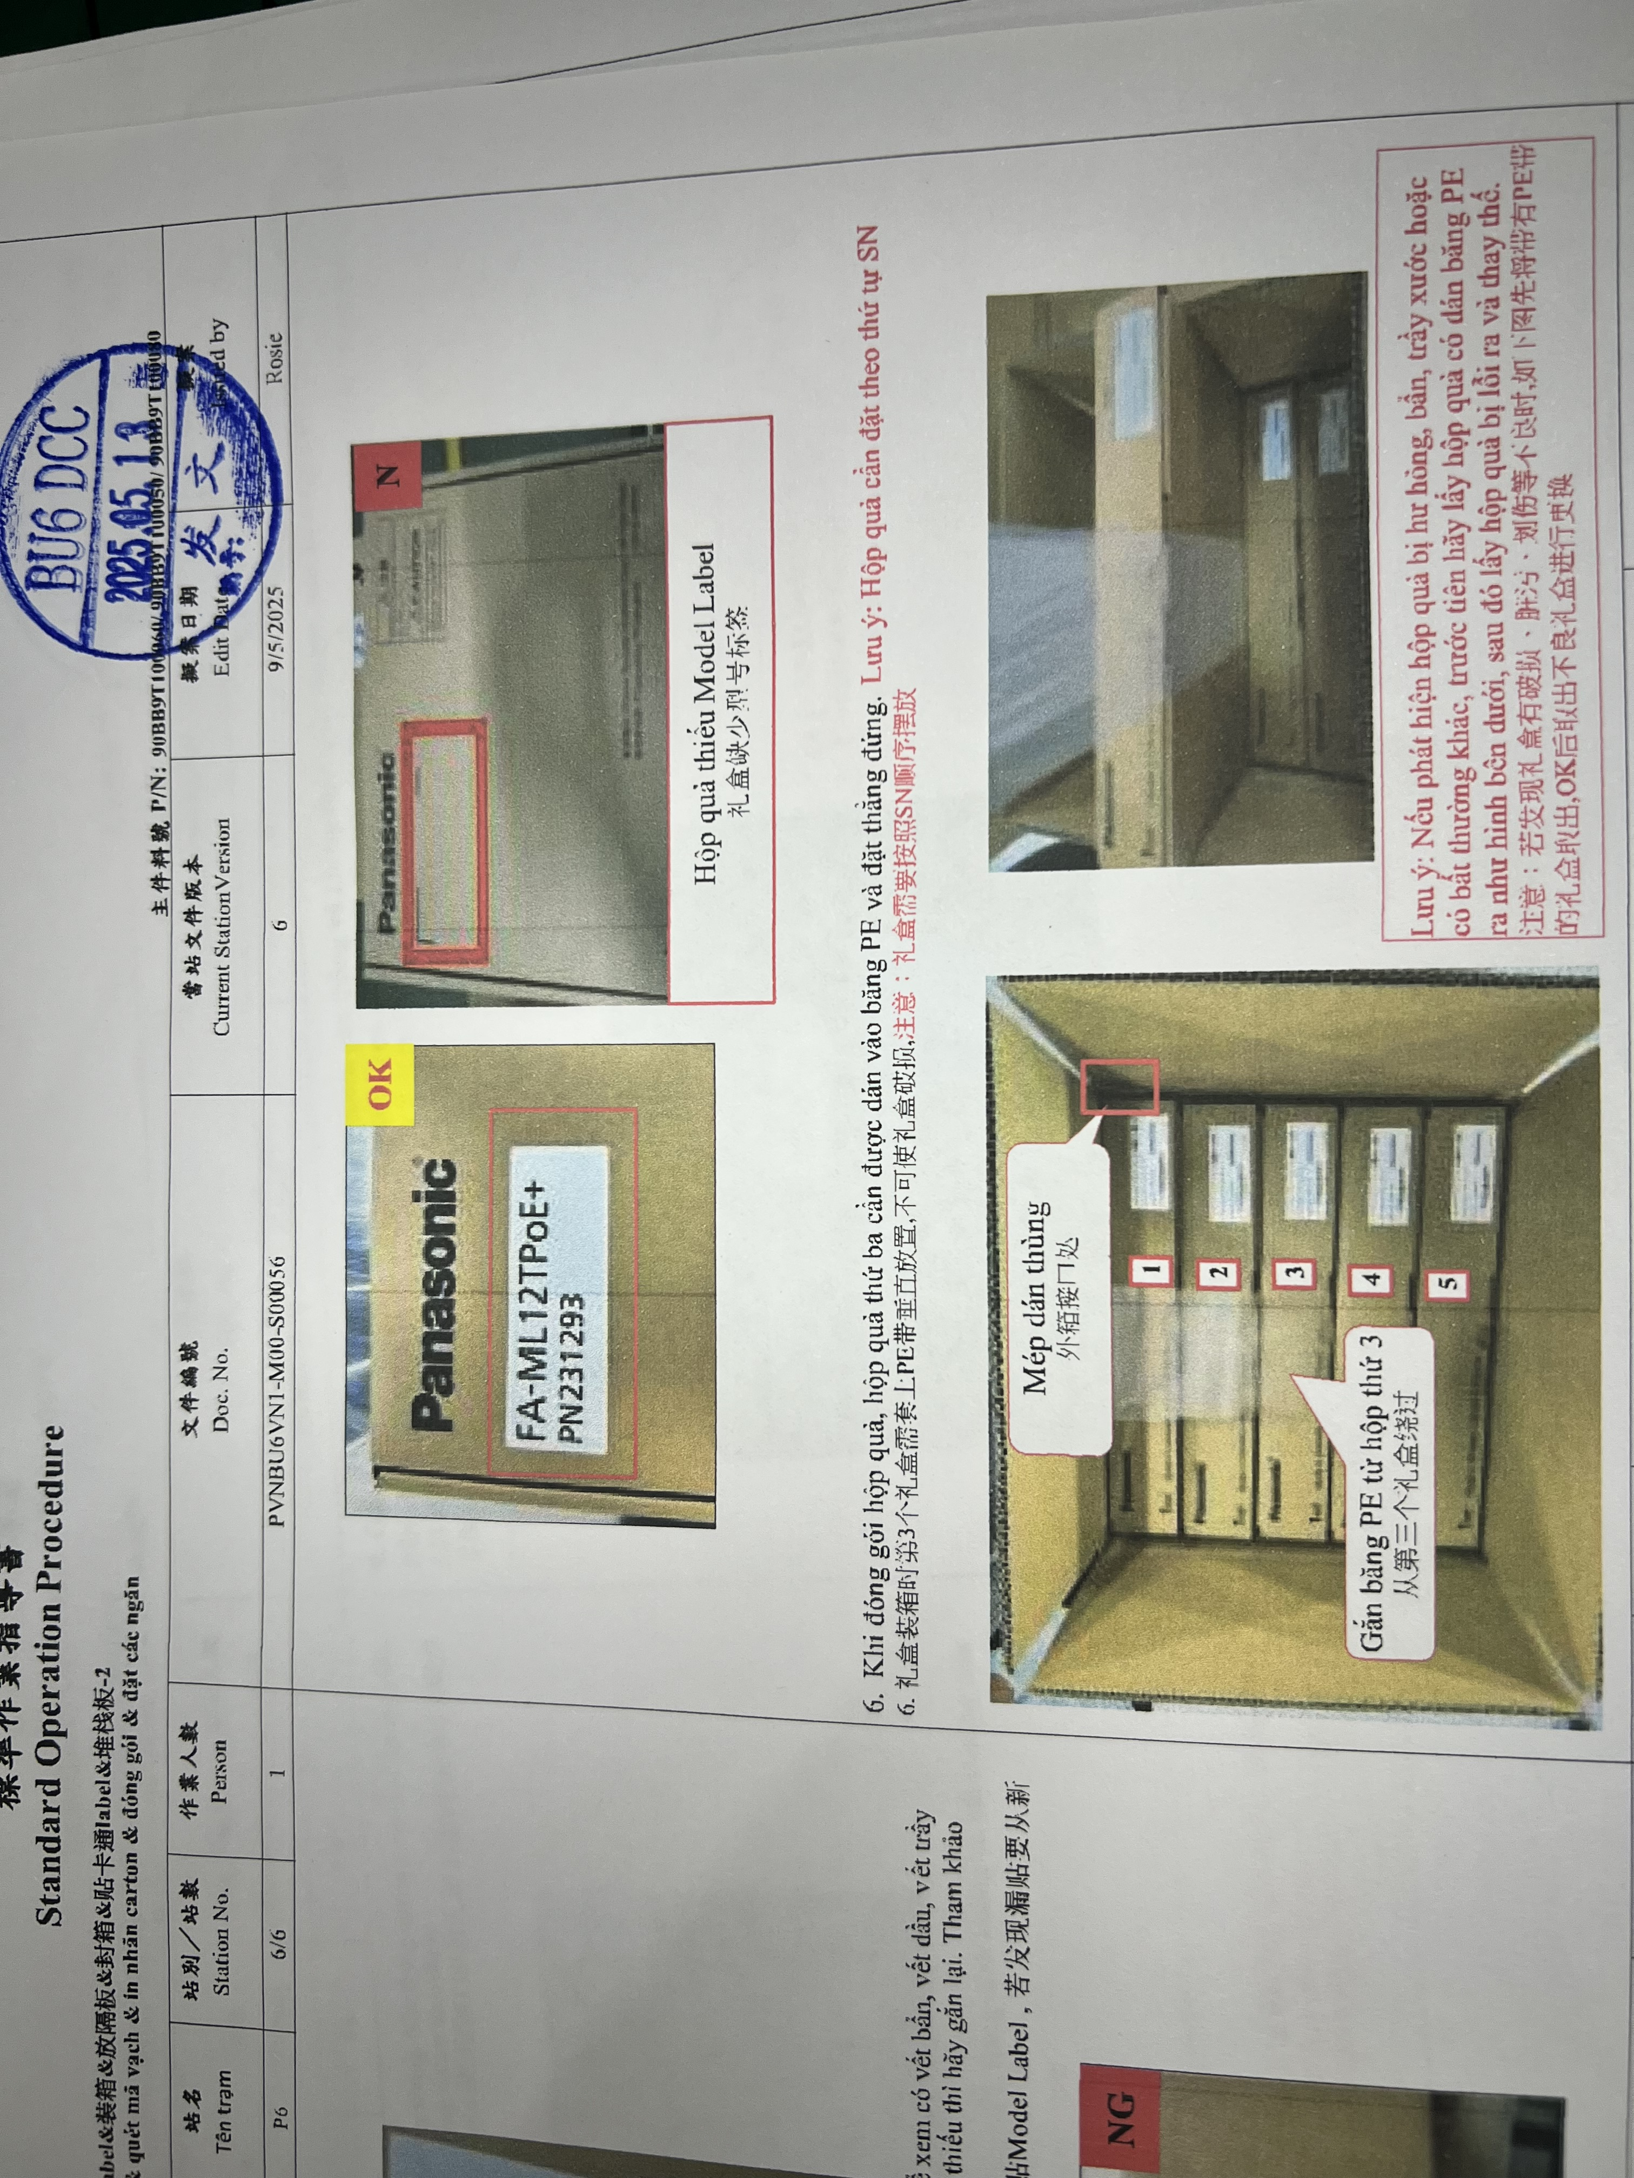
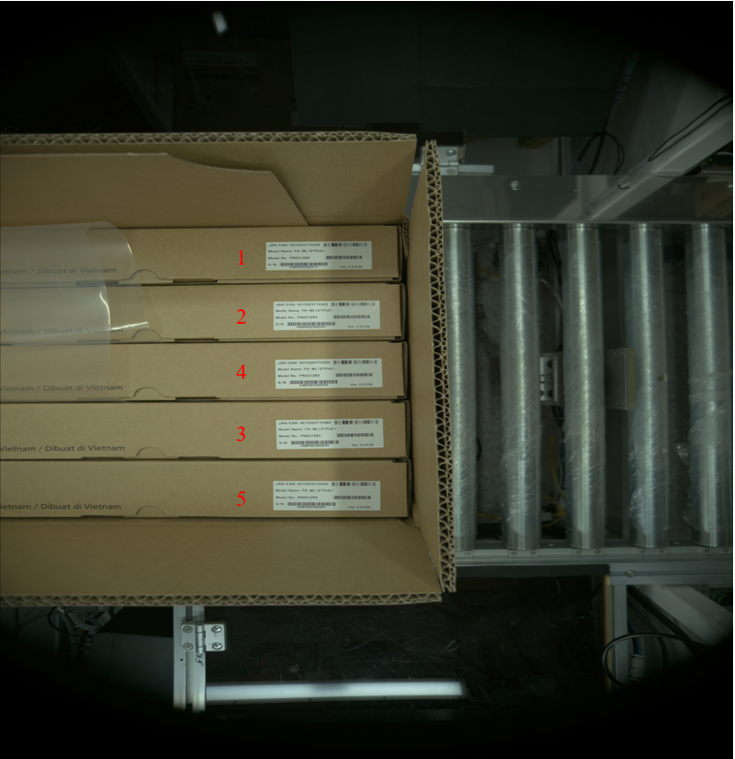
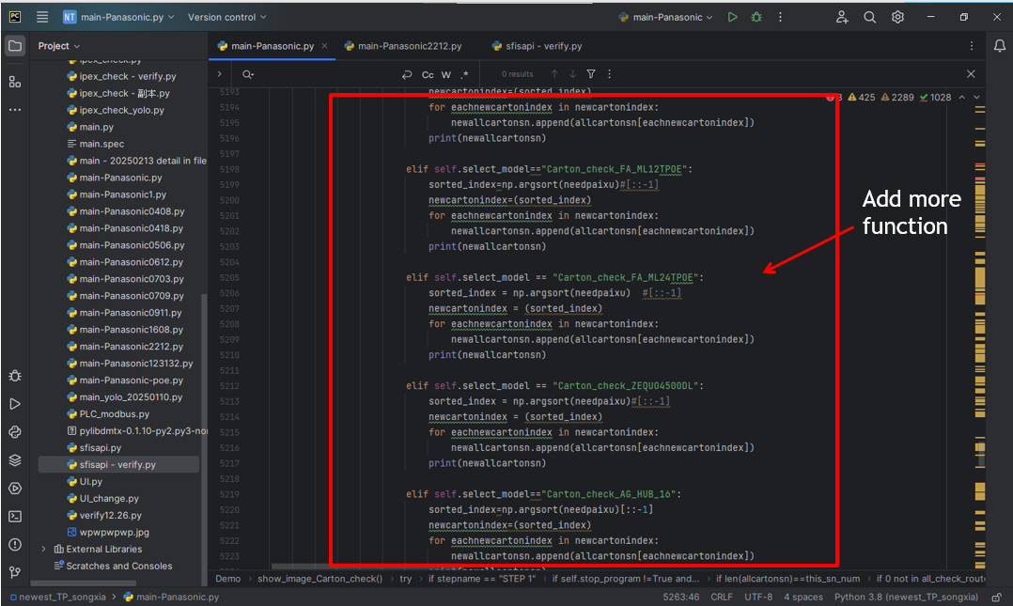
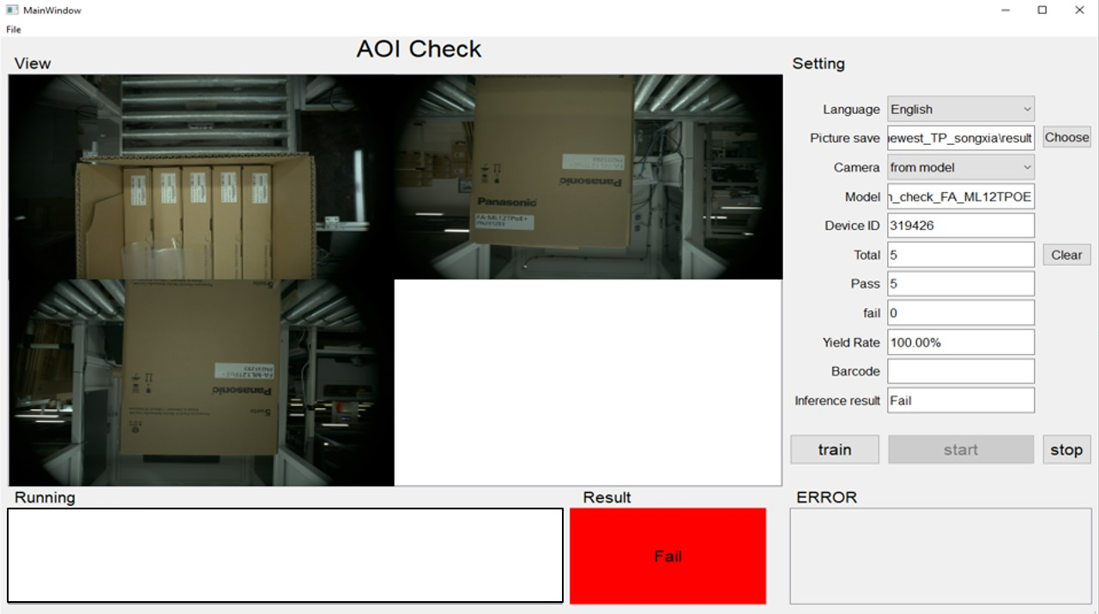
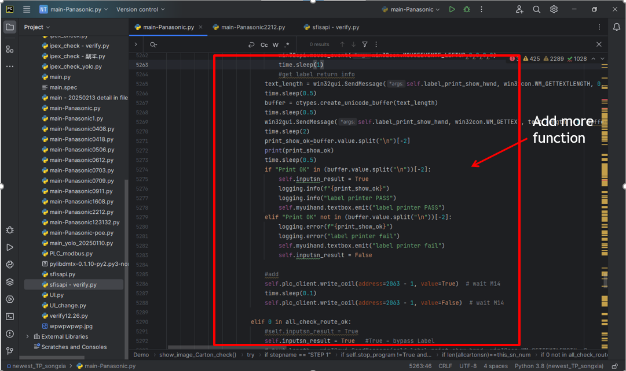
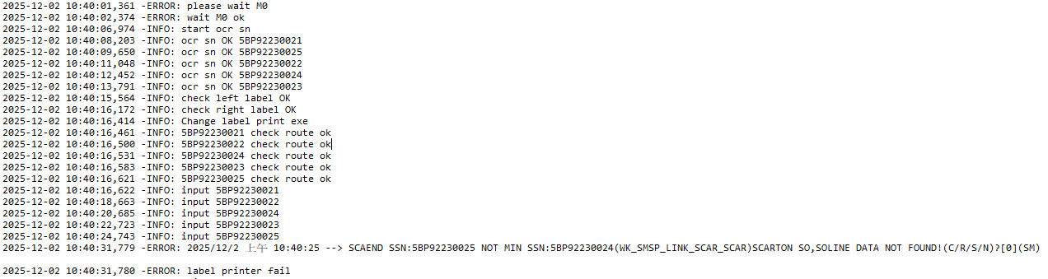
BG6
PVN
PVN- LINE 4K- Improve station AOI Carton
Location: 4K – Panasonic – Station AOI Carton
Model: Model Panasonic
Improvement: Improve station AOI Carton
Before Improve
During production: The Operator (OP) may make incorrect actions and arrange products not according to SOP
This leads to failure in ensuring the quality and accuracy of the carton packaging process.
Details Improve
Program Improvement :
Added a camera function to check the product status and ensure all units are correctly arranged inside the carton.
If the unit is not placed at the correct position => The program fails and carton printing is disabled.
PLC Improvement :
Integrated PLC checking to verify the product quantity and correctness.
When the operator arrange product incorrect => The program fails => Red warning light and alarm signal are activated
Station P6 (Carton Label) before improve
After Improve
The AOI system automatically verify carton arrangement before printing label.
Incorrect cartons are detected immediately and prevented from entering the next process
Operator dependency is reduced, ensuring consistent packaging quality
Station P6 (Carton Label) after improve
FME
BG6 PVN

